Slide 1


Case Management Hearing
Enhancing
Efficiency and Effectiveness

Slide 2
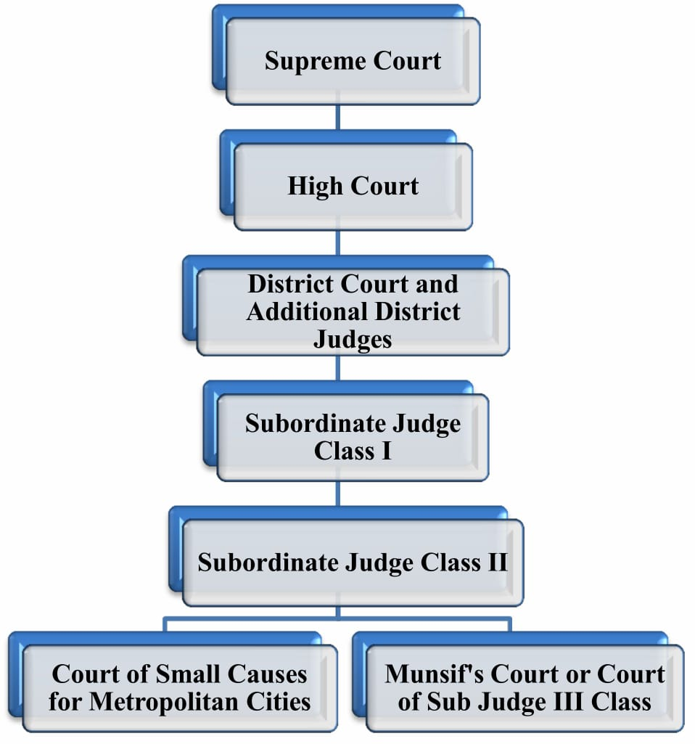
Indian judiciary
On 26 January 1950, the day India’s constitution came into force, the Supreme Court of India was formed in Delhi.The original Constitution of 1950 envisaged a Supreme Court with a Chief Justice and7 puisne Judges – leaving it to Parliament to increase this number. In the early years, all the Judges of the Supreme Court sit together to hear the cases presented before

Slide 3


Introduction: Why Case Management Hearing is needed?
Justice delayed is justice denied.

Slide 4

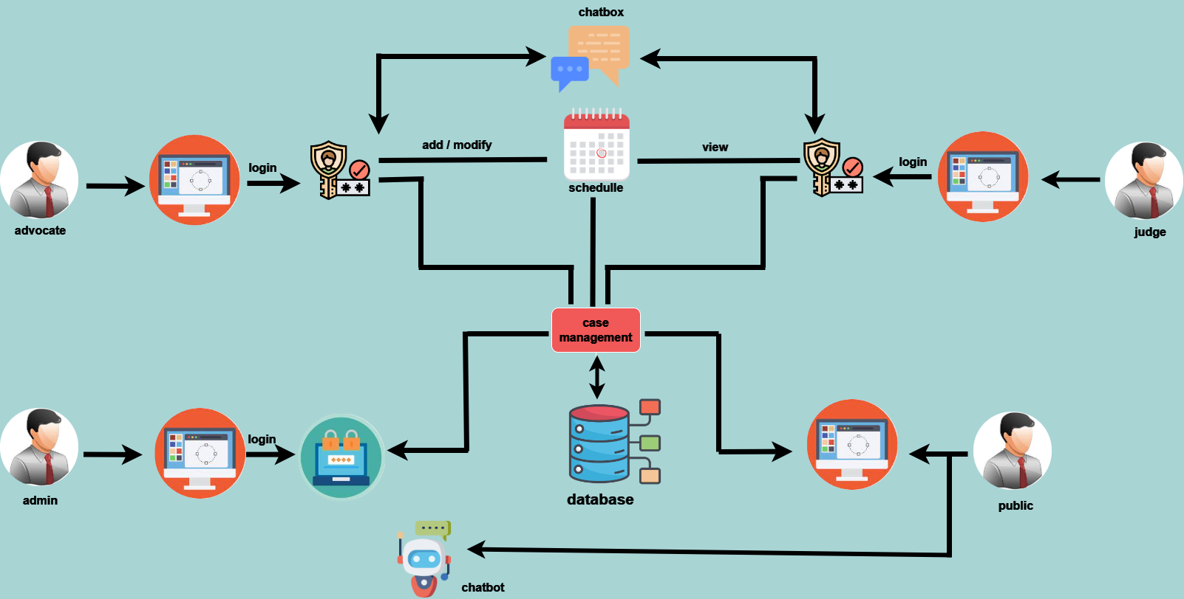
Architecture

Slide 5

Importance of Effective Case Management and Hearing Scheduling
Reduced Delays
Improved Resource Allocation
Efficient case management and hearing scheduling minimize delays, ensuring timely resolution of legal matters.
By effectively managing resources, including judges, courtrooms, and staff, we optimize operational efficiency.
Enhanced Access to Justice
Efficiently scheduled hearings and coordinated case management promote equal access to justice for all individuals.

Slide 6
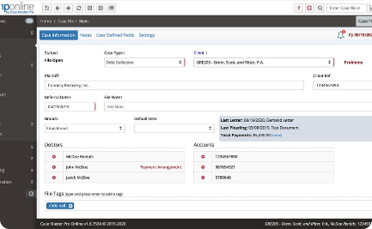
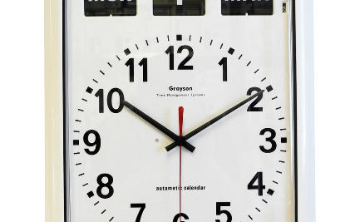

Benefits of Our Project
Intuitive Case Management Software
Efficient Hearing Scheduling
Enhanced Collaboration
Stay organized, track case progress, and access crucial information with our user-friendly software.
Streamline hearing scheduling and optimize resource allocation for improved courtroom efficiency.
Promote seamless communication and collaboration among stakeholders, including judges, attorneys, and support staff.

Slide 7





Key Features of the E-Portal
Schedule Management
Electronic Filing
Video Conferencing
Document Collaboration
Secure Access
Notification alerts

Slide 8



Key features
User Experience Design
﻿
Simplicity and Intuitiveness
Clear Navigation
Responsive Design

Slide 9
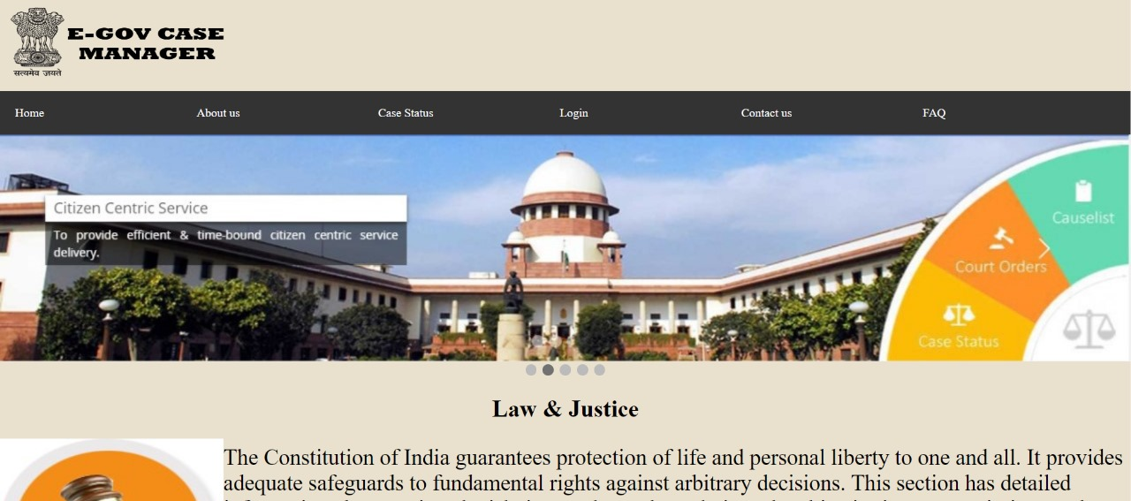
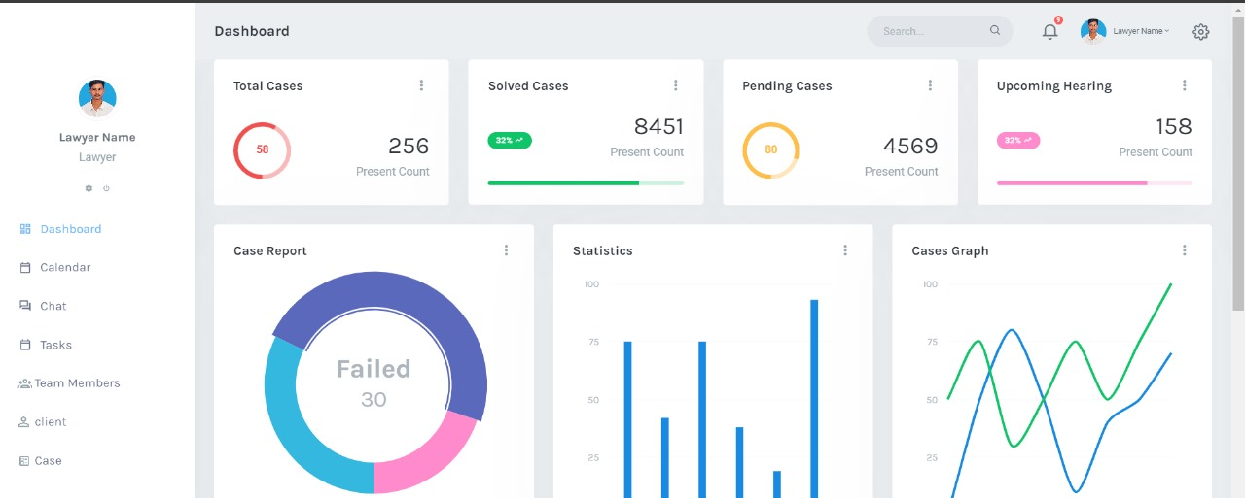
Home page
Dashboard

